Slide 1


Africa Natural Capital Accounting Community of Practice Webinar Series:
The Use of Natural Capital Accounts in Policy Scenario Analysis
Professor Andrea Bassi
Thursday, October 29, 2020

Slide 2
Outline
Introduction: setting the stage
Module 1: Policy scenario analysis and forecasting
Module 2: Models, scenarios and accounts
Module 3: Policy assessments with models and scenarios
Module 4: Steps to follow for your own assessment!

Slide 3
Introduction: setting the stage

Slide 4




Objectives of the report
The interdependent nature of the 17 Sustainable Development Goals and underlying indicators of the 2030 Agenda for Sustainable Development embodies the need for a systemic approach to tackling the challenges facing humanity.
Attaining one goal at the expense of another is neither desirable nor sustainable
Progress on one goal can contribute to another: poverty can only be eliminated through decent work and economic growth.
Failure on one goal will lead to negative progress on another
Policymakers require new sources of data, based on coherent statistical frameworks, that can be transformed into decision-relevant information through the application of innovative, sophisticated modelling techniques.
The use of the ecosystem accounts of the SEEA EEA in scenario analysis models can provide policymakers with better understanding of the interconnections existing between society, economy and the environment, and hence lead to better decisions.

Slide 5




Rationale for this guide
Ecosystem accounts are by nature backward-looking: they describe the state of affairs at some point in the past, which may be relevant for a whole range of policies.
Policymaking is, by contrast, forward-looking: it seeks to influence future states of affairs based on decisions taken today.
The challenge, then, is how to marry the two.
The guide focuses on the use of backward-looking data in forward-looking policy scenario analysis that allows policymakers to assess the possible impacts of their choices.
The utility of such an approach is demonstrated by the work carried out by The Economics of Ecosystem and Biodiversity (TEEB) in various countries and policy areas.

Slide 6
Module 1:
Policy scenario analysis and forecasting

Slide 7
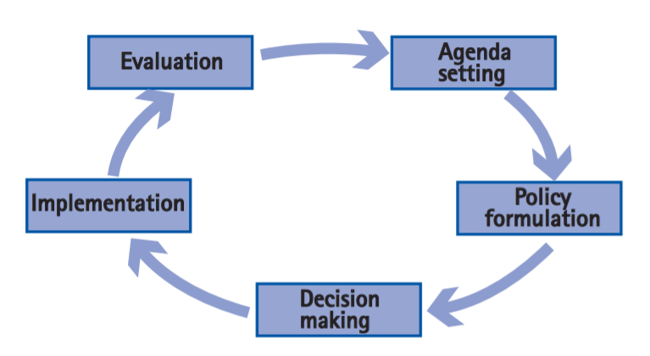
The policymaking process
The policymaking process includes five broad steps: (1) issue identification (or agenda setting), (2) policy formulation (including identification of intervention options and their assessment), (3) decision making (or policy adoption), (4) policy implementation, (5) monitoring and evaluation.

Slide 8
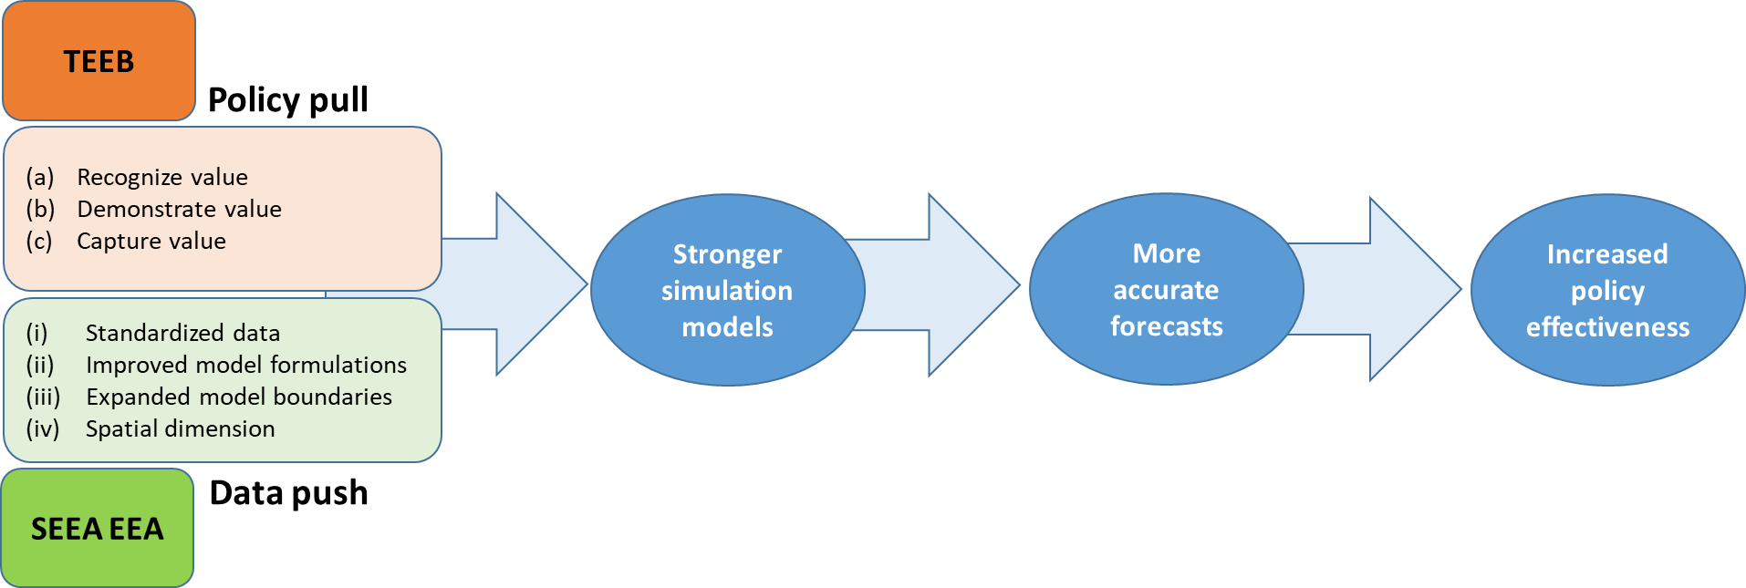
Data push and policy pull
There are different entry points for the use of SEEA EEA in scenario and forecasting exercises, both originating from the institutionalization of the accounts and emerging from the need of specific policy assessments, on demand.
A “data push” approach driven by the availability of new information
A “policy pull” case where the use of SEEA EEA data is requested to carry out a comprehensive policy assessment, are both important.
The TEEB Approach and the SEEA EEA are complementary
initiatives to better informed policymaking.

Slide 9
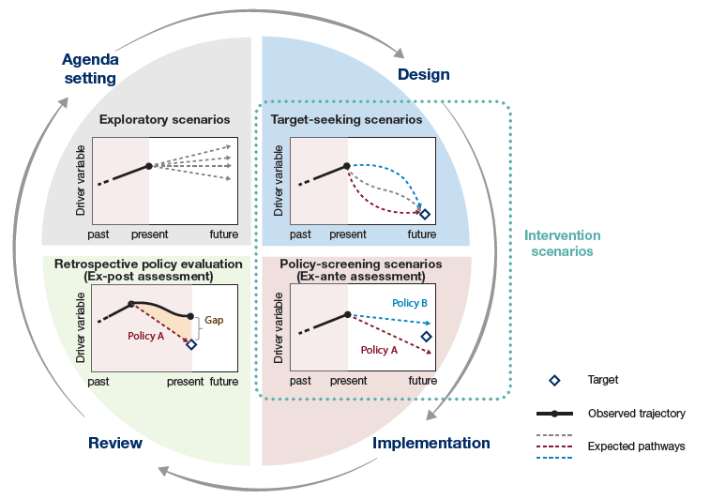
Scenarios and forecasting methods
The various types of scenario that can be used in policy scenario analysis are usefully classified into (a) exploratory scenarios, (b) target-seeking scenarios, (c) policy-screening scenarios and (d) retrospective policy evaluation. This characterization is consistent with the potential for scenarios to inform policymaking primarily in the agenda setting and design phase, and for monitoring and evaluation after implementation.
Roles played by different types of scenarios (referred to as “simulations” in this report when these scenarios are quantified) corresponding to the major phases of the policy cycle (IPBES, 2016).

Slide 10
Exercise!
Can you match the examples to the types of scenarios in the figures?
What is the impact of introducing a PES, or an incentive for renewable energy?
What are the consequences of a continued increase in the use of chemical fertilizer?
How much does it cost to conserve 300 hectares of forest?
How effective has been the introduction of efficient irrigation in the past 10 years?
Roles played by different types of scenarios (referred to as “simulations” in this report when these scenarios are quantified) corresponding to the major phases of the policy cycle (IPBES, 2016).
Notes:
Agenda setting: What are the consequences of a continued increase in the use of chemical fertilizer?
Design: How much does it cost to conserve 300 hectares of forest?
Implementation: What is the impact of introducing a PES, or an incentive for renewable energy?
Review: How effective has been the introduction of efficient irrigation in the past 10 years?

Slide 11

The relevance of SEEA EEA and TEEB for policy analysis
The SEEA EEA and TEEB can both support the use of accounts, further development of modelling approaches and creation of new models, all with the ultimate goal of informing policy decisions.
This can happen through:
Creation of new knowledge about ecosystems and how their extent and quality leads to ecosystem services that benefit communities and human wellbeing.
Creation of coherent and harmonized accounts, allowing for the development of new models that can make use of such a data framework
Promotion of the use of a systemic (closed-loop) approach, closing the loop between models that assess (a) the impact of human activity on ecosystem and (b) models that determine the extent to which ecosystems influence human health and human activity.

Slide 12
The relevance of SEEA EEA and TEEB for policy analysis
Design of new integrated or coupled models: (a) Improving the analysis performed with sectoral models, by introducing physical indicators on ecosystem extent, condition, services and hence generating a higher degree of realism; (b) generating knowledge on how existing models could be connected with one another to better represent the relations between society, economy and environment; (c) providing information for the creation of new integrated models.
Use of simulations, extending the analysis provided by SEEA, by forecasting or back-casting scenarios.
Making explicit the importance of site-specific drivers of change, system responses and impacts, with the use of a spatially-explicit analysis that allows to determine the value of ecosystem services based on the location where these are used (i.e. more explicitly assess demand and supply).

Slide 13
Module 2:
Models, scenarios and accounts to inform policy scenario analysis

Slide 14


Simulation Models
Several simulation models are available, using different modeling approaches, focused on different sectors and domains, geographies, and policy processes.
One of the reason for having so many models is the difficulty in integrating knowledge, which leads to the continuous creation of new models in different fields.
The strength of the SEEA is that it provides knowledge and data to connect the environment with society and the economy, with a spatially explicit approach.
This is the information needed to connect domains of research and integrate many of the models that are currently being used in isolation.

Slide 15





Simulation Models – key features
Sectors: the outcomes of events, including external factors and human decisions, have to be analyzed for a variety of sectors. They are necessary to assess a system’s performance, rather than focus only on its parts.
Economic actors: the assessment of outcomes across economic actors has to consider ecosystems. This is because certain groups of the population and certain businesses rely on natural resources and on ecosystem services and ecosystem goods more than other.
Dimensions of development: sustainable development has three pillars, society, economy and the environment. It is critical that all pillars are treated as part of the same system, to avoid that advances for one do not lead to challenges for others.
Time: the outcomes of decision making, including policies and investments, as well as behavioral change, have to be assessed for the short, medium and longer term
Space: location is even critical when estimating ecological outcomes, such as for the provision of ecosystem services and their economic valuation and for the assessment of the vulnerability (or efficiency) of infrastructure.

Slide 16
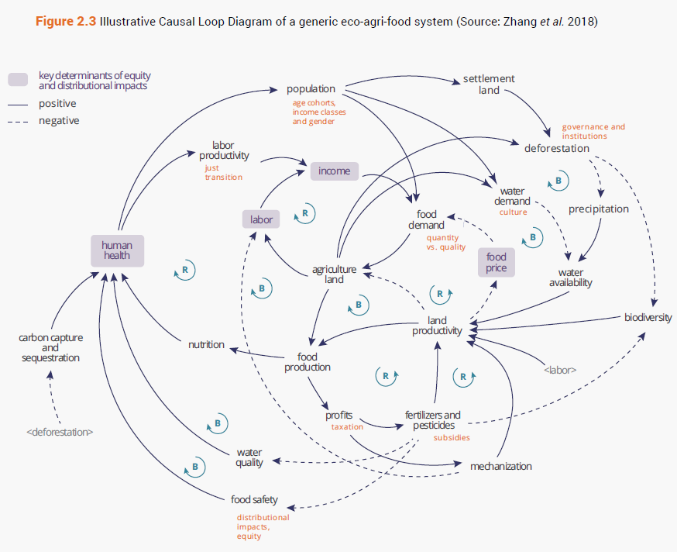
Scenario creation tools (qualitative)
System maps: a causal loop diagram (CLD) is a graphical representation of the main variables forming a system and their interconnections. As a map of the system analyzed, a CLD facilitates representation and exploration of the complexity of the system, with the use of causal relations and feedback loop.
Causal Loop Diagram of the eco-agri-food system. Source (Zhang, 2018)

Slide 17

Scenario forecasting with simulation models (quantitative)
Simulation models are presented as (a) thematic, or sectoral models and (b) cross-sectoral, nested or integrated models.
Thematic models focus on a single theme or area of analysis (e.g. economy, employment, energy, water, land), are generally sectoral and focus in the vast majority of cases exclusively on biophysical or economic indicators.
Cross-sectoral models are also called integrated models. These models consider the interconnections existing across various sectors that include social, economic and environmental indicators, and are either built as nested models

Slide 18

Scenario forecasting with simulation models (quantitative)
Land use models:
Spatial planning tools are used to plot out future optimal physical placement of economic activities, human settlements, based on a variety of scenario drivers.
On the other hand, this is often without reference to what this means for socioeconomic effects or monetary valuation of loss/gain in natural capital assets.
They are often static assessments that do not ‘speak to’ decision-makers outside of land use/conservation planners, but provide very valuable inputs for planning of infrastructure as well as to assess impacts on ecosystems.

Slide 19
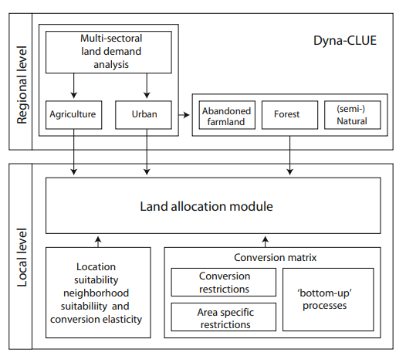
Scenario forecasting with simulation models (quantitative)
Land use models: examples
The Conversion of Land use and its Effects (CLUE) model, a dynamic, spatially explicit land use and land cover change model, is among the most frequently used land use models globally.
CLUE constitutes a flexible and generic land use modelling framework and allows scale and context specific applications, depending on the requirements of the analysis.
Overview of the inputs to model and allocation module of the Dyna-CLUE model (Verburg & Overmars, 2009)

Slide 20
Scenario forecasting with simulation models (quantitative)
Land use models
Model type | Sector/thematic area | Actors | Dimensions of development | Time | Space
Land use (spatial planning) | Land, agriculture | Generally not specified (but may include considerations on land tenure and production, and so public and private sector) | Primarily environmental. May include economic (e.g. agriculture production) and social considerations (e.g. land tenure) | Snapshot, forecasts outcomes for a given point in time | Explicitly represented
Contribution of SEEA EEA: 1-New and standardized data inputs 2-Improved equations (improved understanding of dynamics) for possible land cover change 3-New indicators (extended model boundaries), including new potential factors determining the extent to which land use could change

Slide 21

Scenario forecasting with simulation models (quantitative)
Macroeconomic models: used to perform economic assessments at the regional, national and sectoral level. An example of the use of these models is for the estimation of the impact of fiscal policy. Two main approaches are found, based on general equilibrium (optimization) and econometrics.
Computable General Equilibrium (CGE) models are a tool of economic analysis. The three conditions of market clearance, zero profit and income balance are employed by CGE models to solve simultaneously for the set of prices and the allocation of goods and factors that support general equilibrium.
Econometric models function by collecting historic data on a range of variables and using economic theory and statistical techniques to determine how a change in one variable is correlated with changes in others. This type of model is not based on an attempt to theorize how an economy works (despite being nevertheless theory-based), instead it measures how it has evolved based on actual data.

Slide 22
Scenario forecasting with simulation models (quantitative)
Macroeconomic models: potential structural improvements with SEEA EEA
Extent:
for production - can inform the estimation of whether the land resources required to maintain and expand economic production are available. This implies that land requirements for different economic activities are estimated and compared with available land (considering al land cover classes) and potential future land cover change. In this respect, the use of extent data can indicate whether land-related constraints may emerge in the future.
for impacts of production - for both CGE and macroeconometric models the inclusion of new variables on land use can support the estimation of the impact of economic production on land cover, and as a result on potential changes in the condition of ecosystems and provisioning of ecosystem services.

Slide 23
Scenario forecasting with simulation models (quantitative)
Macroeconomic models: potential structural improvements with SEEA EEA
Condition:
for production - can support the estimation of the economic productivity of land, using biophysical data and increasing the accuracy of projections (e.g. for agriculture, forestry or all land-based sectors for instance).
for impacts of production – new variables could be added to the model that indicate environmental pressures emerging from activities that affect condition but not extent (e.g. land management practices, logging practices).

Slide 24
Scenario forecasting with simulation models (quantitative)
Macroeconomic models: potential structural improvements with SEEA EEA
Ecosystem services:
for production – including ecosystem services in macro models could support the assessment of productivity at the sectoral level. It could shed light on the extent to which water quality, air quality, soil erosion and other ecosystem services can contribute to economic productivity (or conversely, on the extent to which production relies on ecosystem services). This could be introduced through the use of “productivity shocks” in the model, resulting from changing ecosystem service provisioning.

Slide 25
Scenario forecasting with simulation models (quantitative)
Macroeconomic models: potential structural improvements with SEEA EEA
Economic valuation:
for production – could inform the extent to which production costs may change in case of declining ecosystem services. This in turn may affect economic growth projections (sectoral and national level) and contribute to more holistic assessments of economic development. In the case of CGE models, this implies that the optimization algorithm would consider an extended set of parameters (i.e. the environmental dimension and its impact on production costs).

Slide 26
Scenario forecasting with simulation models (quantitative)
Macroeconomic models: Interpretation of results
Macroeconometric models use data to estimate model formulation. With more data and more knowledge of causality for ecosystem extent, condition and services, these models could be greatly enhanced.
CGE models use optimization, and the results of simulations will change when new factors are included in the objective function (e.g. when the loss of ecosystem services translates in costs).
Model boundaries for both types of models could be expanded, including environmental dimensions more explicitly in the estimation of economic performance.
Spatial information may provide more insights as to the emergence of environmental problems (e.g. water and air pollution), informing policy development to avoid the emergence of these tradeoff-related costs.

Slide 27

Scenario forecasting with simulation models (quantitative)
Infrastructure models
Model type | Sector/thematic area | Actors | Dimensions of development | Time | Space
Infrastructure | Energy supply, buildings, roads, water supply and treatment, waste management, natural infrastructure | Generally focused on private sector (contracted entity), but may extend to operators (e.g. government) and recipients of infrastructure benefits (society, households and private sector) | Primarily economic. May include environmental (e.g. deforestation, emissions) and social considerations (e.g. access to services, side effects of construction) | Continuous time (monthly, quarterly or annual projections) | Not explicitly included for national assessments, explicitly represented for project-level analysis
Contribution of SEEA EEA: 1-New and standardized data inputs 2-Improved equations (improved understanding of dynamics) for the impacts of infrastructure on the environment 3-New indicators (extended model boundaries) for the inclusion of the impact of ecosystem services on infrastructure (full feedback loop), including how costs and revenues may be impacted 4-Spatial disaggregation/interpretation of results, making project-level assessments more valid and allowing to include environmental considerations in national-level assessments

Slide 28
Module 3:
Policy assessments with models and scenarios

Slide 29


Overview of policy areas and related priorities
Outcomes may be an endpoint of modeling, but represent a starting point for decision making
According to UNEP (2011), it is possible to group intervention options in four different categories:
Investments
Incentives and disincentives
Land use planning
Awareness raising programs
Each of these are a suite of interventions that impact on, directly or indirectly, climate change, biodiversity loss, air and water pollution, deforestation, land degradation and desertification.

Slide 30
Overview – policy focus
 |  | Climate change | Biodiversity loss | Air and water pollution | Deforestation | Land degradation and desertification
1 | Low Carbon Development in Indonesia | X |  | X | X
2 | Agriculture expansion in the face of climate change in Tanzania | X | X | X | X | X
3 | Biodiversity and tiger habitat conservation in Indonesia | X | X |  | X | X
4 | Forest certificates for reducing deforestation in Brazil |  | X |  | X
5 | Water pollution reduction in India and Sri Lanka | X |  | X | X | X
6 | Deforestation and development planning in Rwanda |  |  |  | X | X
7 | Integrated planning for ecosystem conservation in the Heart of Borneo |  | X |  | X | X

Slide 31

Agriculture expansion in the face of climate change in Tanzania
Policy context and overview of the issue
The Government of Tanzania aimed to provide funding for the implementation of the Southern Agriculture Growth Corridor of Tanzania (SAGCOT). These policies seek to reduce poverty and ensure food security, in line with the Sustainable Development Goals.
The Kilombero basin in Tanzania covers an area larger than 40.000 km2, and it is characterized by high levels of poverty due to low rates of agricultural productivity and investments.
The initiative recognizes possible conflicts of interest, such as competition of resources between farmers and livestock breeders, including land and water. The availability of natural resources and ecosystem services underpin livelihoods for the local population and sustain ecological integrity in the Kilombero valley.

Slide 32

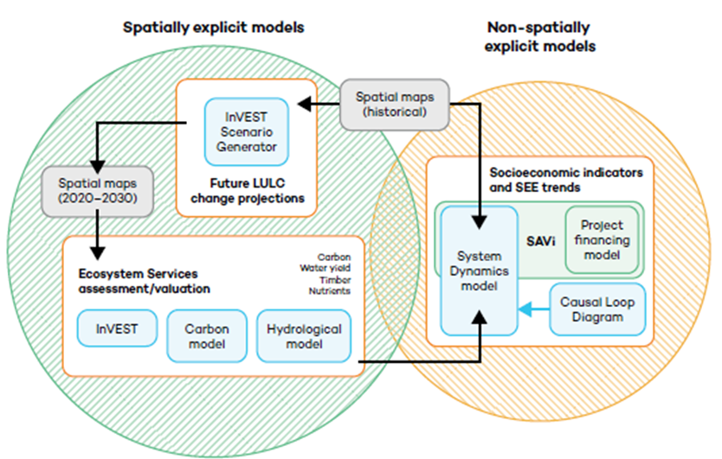
Agriculture expansion in the face of climate change in Tanzania
Modeling approach
Five quantitative models were used, supported by surveys on land use and land management practices, and land cover maps to better understand socio-economic and environmental dynamics of the basin.

Slide 33

Agriculture expansion in the face of climate change in Tanzania
Scenarios
Business-as-usual (BAU): this scenario assumes that existing trends on population, land conversion for agriculture and settlements, and related impact on the environment will be stable.
SAGCOT Reference (RE) and Green Economy (GE): these two scenarios represent two different SAGCOT implementation options; one using flood irrigation (reference or RE) and the second one utilizing drip irrigation (green economy or GE).

Slide 34

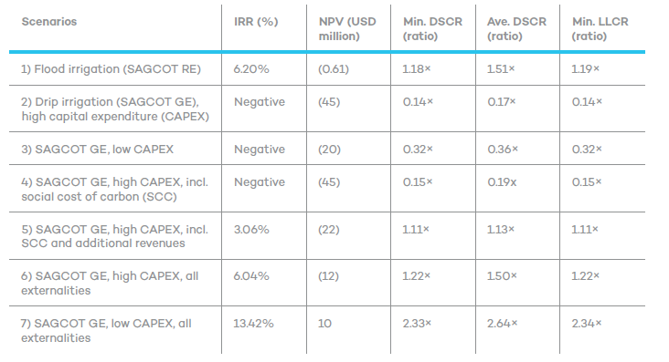
Agriculture expansion in the face of climate change in Tanzania
 | land use | water stress | carbon sequestration | production | employment
SAGCOT | ↑ | ↑ | ↓ | ↑ | ↑
water constraints | ↓ | ↑ | ↑ | ↓ | ↓
water efficiency (30%) | = | ↓ | = | ↓ | ↓
intensification (50%) | ↓ | = | ↑ | = | ↓
combination | ↓ | ↓ | ↑ | = | =
Results of the analysis
Key financial indicators for investments in flood (SAGCOT scenario) and drip irrigation (SAGCOT GE scenario). Source (IISD, 2018)

Slide 35
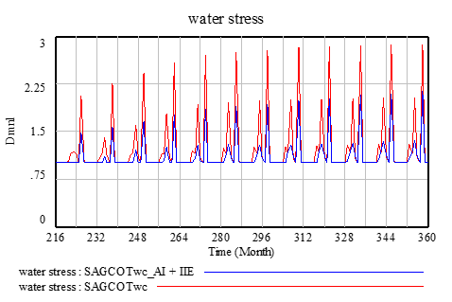
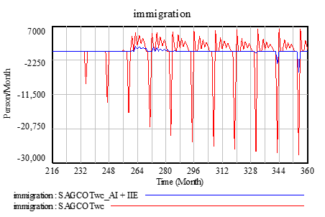
Agriculture expansion in the face of climate change in Tanzania
Results of the analysis

Slide 36

Agriculture expansion in the face of climate change in Tanzania
Potential contribution of SEEA-EEA to the case study
The modeling work presented in this study makes use of spatial information, incorporating ecosystem extent.
On the other hand, the analysis of ecosystem condition is limited to crop production and water availability.
Refining and deepening ecosystem condition would provide more valid results.
Expanding the list of ecosystem services, in addition, would allow to improve model formulations for crop production, water use, with validated accounts.
It would then support expanding the cost benefit analysis, with new economic valuation of ES.

Slide 37
Agriculture expansion in the face of climate change in Tanzania
Potential contribution of SEEA-EEA to the case study
Ecosystem extent | Ecosystem condition | ES supply and use, physical | ES supply and use, monetary | Thematic accounts
Required to better determine the land cover changes caused by expansion of agriculture. Indicators: Subtropical deciduous forests and shurblands Subtropical wooded savannas Subtropical grasslands Croplands Pastures Plantations Mangroves Permanent upland streams Permanent lowland rivers | Useful to better estimate ecosystem services, especially in relation of crop production and water. Indicators: Biomass of natural forest Living plant index Nutrient concentrations (N) Nutrient concentrations (P) Habitat quality | Required to expand the list of ES quantified, and to improve the calculation of ES provisioning. Indicators: Carbon retention Blue carbon retention Soil retention Crop provisioning Timber provisioning Air filtration Water regulation Water purification | Necessary to better assess the economic viability of the project, from a societal perspective. Indicators: Value of carbon and blue carbon retention Value of crop provisioning Value of water supply and purification | Water accounts would be valuable to extend the analysis to the Rufiji delta (e.g. to lowlands) and to improve the calculation of the societal impacts of agriculture expansion (including for the calculation of project IRR for the government and farmers).

Slide 38
Deforestation and development planning in Rwanda
Policy context and overview of the issue
In 2011, Rwanda’s Government set the ambitious goal to restore 2 million hectares of the country’s forest cover under the Bonn Challenge, a global goal to bring 150 million hectares of degraded and deforested landscapes into restoration by 2020.
Through a collaboration funded by the Science for Nature and People Partnership, the Integrated Economic-Environmental Modeling (IEEM) model was developed, a macroeconomic Computable General Equilibrium (CGE) model that incorporates land use and SEEA accounts.
Specifically, the IEEM Platform was linked with ecosystem services modeling (IEEM+ESM) to better understand and analyze green growth strategies on the relationship between land use dynamics and green growth in Rwanda.

Slide 39
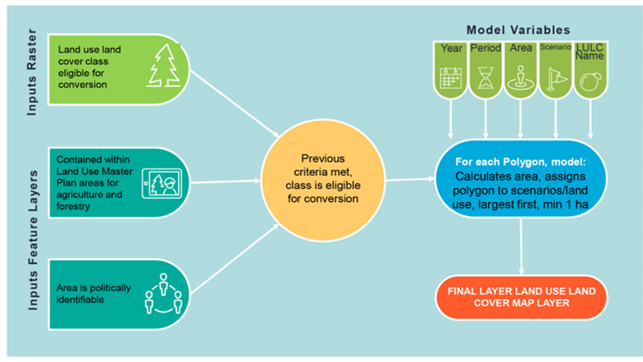
Deforestation and development planning in Rwanda
Modeling approach and scenarios
The IEEM Platform integrates non-material, regulating and cultural and aesthetic ecosystem services by linking IEEM with spatial ES modeling. The bridge between the two modeling frameworks is made possible through a Land Use Land Cover change (LULC) modeling modul.e
Modeling workflow (Banerjee, et al., 2020)

Slide 40
Deforestation and development planning in Rwanda
Scenarios
Name | Description
BASE | Based on business as usual trends.
FOR1 | Forest plantation area is increased by 110,400 hectares to 2035. Total investment cost is US$285,581,699 (US$20,398,693 annually). Land endowment is fixed, therefore forest plantation expansion causes a reduction in land for agriculture.
FOR2 | Forest plantations increased by 110,400 hectares between 2018 and 2035. Cost of the policy is US$285,581,699. Land endowment is not fixed, so forest plantations can expand without reducing availability of agricultural land.
FUEL | Efficient cookstoves and kilns reduce woody biomass used by 25%. Rural household labor productivity is increased by 0.125% due to less work hours lost to acute respiratory diseases, eye disease and burns.
IRRIG | 85,473 ha of farmland currently cultivated without irrigation or with irrigation infrastructure in disrepair are brought into irrigated agricultural production. Irrigation will increase yields and crop values given quality improvements and seasonality of irrigated crops.
FERT | Increase in area and quantity of fer­tilizer applied to all cropland to 45 kg/ha/yr.
COMBI1 | Joint implementation of FOR1, FUEL, IRRIG, and FERT.
COMBI2 | Same as COMBI1 but does not account for urban expansion.

Slide 41
Deforestation and development planning in Rwanda
Results of the analysis
The FERT and COMBI scenarios are the greatest “winners” for economic growth.
From an ecosystem services perspective, the FOR and COMBI scenarios, which help reverse a 25-year trend of forest loss in Rwanda, provide the greatest gains.
Of these, the FOR scenarios yield re­ductions in nutrient export while when combined with fertilization in the COMBI scenarios, the net effect is an increase in nutrient export, though to a lesser degree than the FERT scenario.
Impacts of different scenarios analyzed by the IEEM+ESM platform: difference relative to the baseline scenario in 2035, in million USD (O. Banerjee et al., In press).

Slide 42
Deforestation and development planning in Rwanda
Potential contribution of SEEA-EEA to the case study
The modeling approach considers the relationship existing between economic activity and land use.
Ecosystem condition and ES accounts could be added, leading to the economic valuation of ecosystem services (either model-based or estimated with ES monetary accounts).
Some of these ES are modeled, but not valued monetarily because of the absence of a market price.
With the availability of the economic valuation of ES, these economic values could be used as input in the GCE model.
This would improve the economic assessment, possibly considering other economic losses resulting from the loss of ecosystem services (beyond land), and approximating an assessment of the societal value of intervention options.

Slide 43
Deforestation and development planning in Rwanda
Potential contribution of SEEA-EEA to the case study
Ecosystem extent | Ecosystem condition | ES supply and use, physical | ES supply and use, monetary | Thematic accounts
Required to better estimate the impact of land cover change on ecosystem services. Indicators: Temperate tropical lowland rainforests Temperate tropical montane rainforest Temperate tropical dry forests and shrubs Plantations Croplands Pastures Settlement land Roads | Required to improve the calculation of ES provisioning and for the estimation of habitat quality. Indicators: Biomass of natural forest Species abundance index Living plant index Nutrient concentrations (N) Nutrient concentrations (P) Habitat quality | Required to expand the list of ES quantified with InVEST, better parametrize the model. Indicators: Carbon retention Soil retention Crop provisioning Timber provisioning Water regulation Water purification Species appreciation services Nursery population and habitat maintenance services | Necessary to assess the economic impact of ES provisioning, and the viability of proposed policy options. Indicators: Value of carbon Value of crop provisioning Value of water supply and purification Value of tourism activity | Relevant for the assessment of ES that affect economic activity (e.g. water)

Slide 44
Module 4:
Steps to follow for your own assessment!

Slide 45
Modelling process
Problem formulation
5. Policy formulation
and testing
Modeling is iterative
2. Conceptualization
4. Model testing
3. Formal model
building

Slide 46
Modeling process
1. Identify the problem or policy opportunity
Describe the problem statement in a sentence
Identify one or more indicators that allow to measure the problem
2. Determine causes and effects of the problem
Identify indicators that represent the factors affecting the problem
Identify indicators that represent the effects of the problem
3. Determine the boundaries of the model
Based on the indicators identified, determine internal and external influences
Review existing models and identify what features are critical to assess

Slide 47
Modeling process
4. Choose the model(s) to use
Assess the boundaries of the model, and whether all key causes and effects of the problem are captured
Assess the required data inputs, as compared to data availability
5. Formulate and simulate scenarios
Determine policy assumptions (e.g. targets, cost of interventions)
Simulate the model and validate the results
6. Review and interpret results
Assess results in relation to the problem (is the problem solved?)
Interpret results in relation to social, economic and environmental indicators, especially in relation to causes and effects of the problem

Slide 48
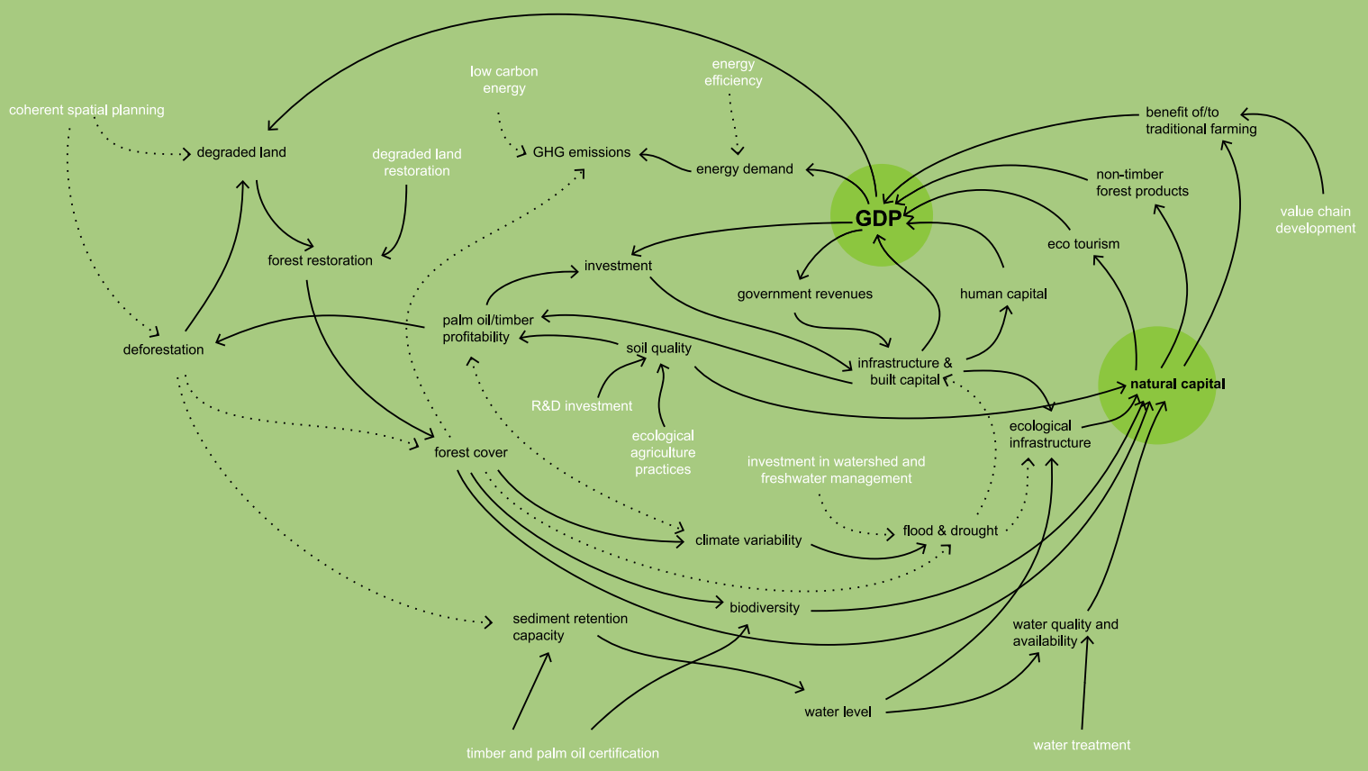
Identifying model boundaries
3. Determine the boundaries of the model
Review existing models and identify what features are critical to assess

Slide 49
Identifying model boundaries
3. Determine the boundaries of the model
Review existing models and identify what features are critical to assess
Energy
Ecosystem service valuation
Macro
economy
Land use
Sectoral production
Infrastructure (green and grey)
Climate
Sediment retention
Water (hydrology)

Slide 50
Conclusions

Slide 51





Key messages
The use of SEEA EEA, providing a standardized set of accounts, allows to bring more of a top-down approach to data collection (in a way similar to the SNA). It would also allow for time series data and hence repeatable analysis as opposed to one-off studies.
The economic valuation of ES requires instead local customization of the approach.
The same can be said about the policy process: unless the local context is taken into account, it will be difficult to gain traction with policy makers at local and national level.
The joint use of SEEA EEA and TEEB therefore bridges several gaps: (i) between top down and bottom up analysis; (ii) between the assessment of historical data and future projections; (iii) between science and policy.
SEEA EEA and TEEB can contribute to the development and refinement of various models and related policy assessments. This is a result of improved knowledge, expanded data availability and improved data quality, expanded model boundaries and creation of more systemic assessments that involve a broader group of local stakeholder.

Slide 52
Moderated Interactive Discussion
Questions for Professor Bassi
Sharing of Country Experiences on the Use of Accounts in Policy

